Slide 1
Introduction to Psychology
Perception – 2
Sumitava Mukherjee

Slide 2

Simple to complex

Slide 3
Perceptual Theory 1:
Constructive Perception
  WE FORM and TEST hypothesis about percepts based on what we sense and what we have in memory.
  Unconscious inference: Spontaneous information integration from multiple sources
  We see with “the brain and the eye”
  Closer to top-down view of sensory processing

Slide 4

Can you find a friend?

Slide 5
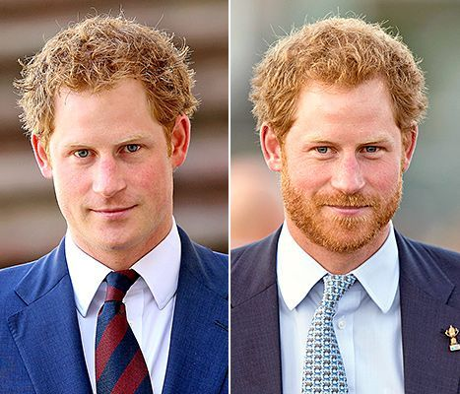
EASY
Understanding patterns in faces

Slide 6
EASY
Understanding patterns in faces

Slide 7
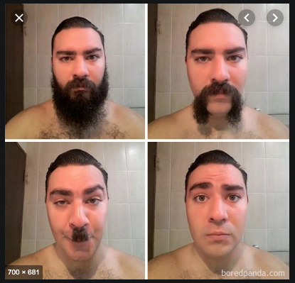
DIFFICULT
Understanding patterns in faces

Slide 8
Perceptual theory 2:
Direct Perception
The stimuli is the important element and not learning and cognition
“Richness of optic array matches the richness of the world” – Gibson
Stimulus contains enough information and does not require internal representation for perception
According to Gibson, visual cues like relative size are not necessary for percepts like depth.

Slide 9
Gibson and pilots
Task: Pilot selection during world war II
Pilots who perform well on depth perception tasks did not fly planes any better (performance plus depth perception)
His reasoning: Traditionally thought cues are not adequate for depth perception
The complex stimuli directly enables action
Akin to a “bottom-up” view

Slide 10

Subjective perception
Illusory contours

Slide 11
The case of illusory contours
Test case to see how the mind organizes visual stimuli
Percepts of form where the form exists in the perceptual-cognitive system, not in the stim
What kind of theories can best explain this?
What happens when you ‘force’ yourself to realize they are not “real”?

Slide 12
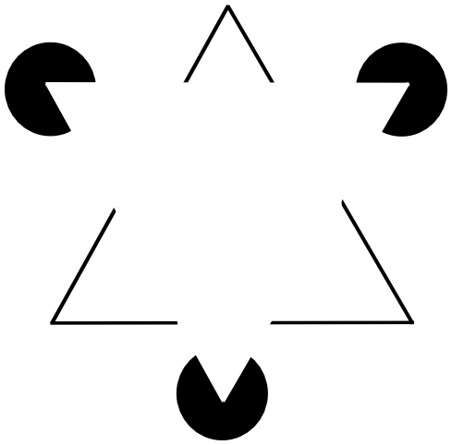
Well-defined features

Slide 13
Observations
Lateral Inhibition: Persistence due to tendency of adjacent cells in the retina to inhibit surrounding cells and hence attenuating contours
Cognitive bionomics view: The need to see edges, forms or motion is a biological necessity
Even in the absence of real lines, fabricating lines from partial information is useful
Purpose is a means to cancel the effects of camouflage (Ramachandran)

Slide 14
Recap of visual pattern recognition
Core question: What are the cognitive processes we must postulate to account for our ability to understand patterns?
  Bottom-up and Top-down processing
    Initiated by the parts of the pattern [bottom-up] vs recognition of the whole leads to understanding its parts [top-down]

Slide 15
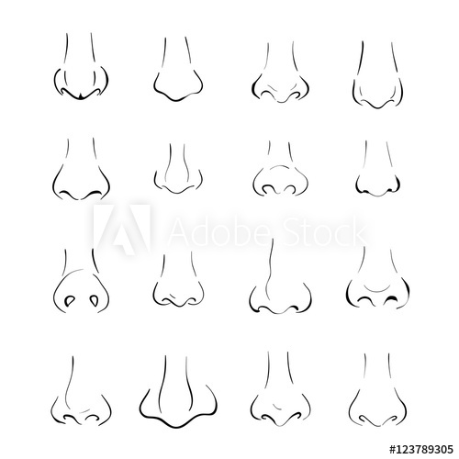
What is this?

Slide 16
Bottom-up vs Top-down
Parsing paradox: What comes first?
Interaction of top-down and bottom-up simultaneously (Palmer)
Expectation (goals) based on real-world knowledge guide identification of objects and hinders identification of inappropriate ones

Slide 17
What part of a face is this?

Slide 18
Theories
  Gestalt Theory (Parts of the entire configuration derive their meaning from their membership to the whole and hence the whole and the parts are dissimilar)
  Template matching (Match between sensory stimuli and its mental form)
  Prototype theory (Match between perceived pattern and an idealized mental pattern)
  Feature analysis (Analysis based on simpler features: bottom-up)

Slide 19
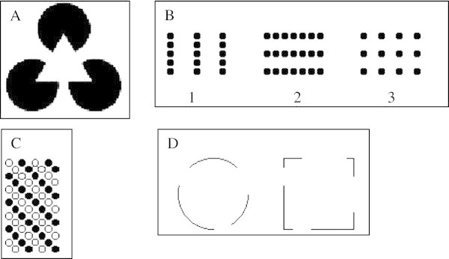
Gestalt principles
All stimuli working together to produce an impression

Slide 20
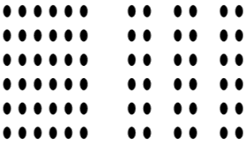
Gestalt psychologists:
Key points
cognition is ecological
Difficult not to see the pattern

Slide 21
Gestalt psychologists:
Key points
The perceptual system is always looking for alternative organizations
Initial idea was spontaneous organization was a property of the stimuli itself but more recent findings show it is also heavily biased through past memories.

Slide 22
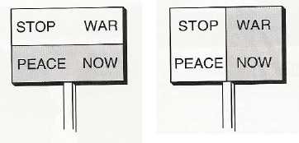

Slide 23
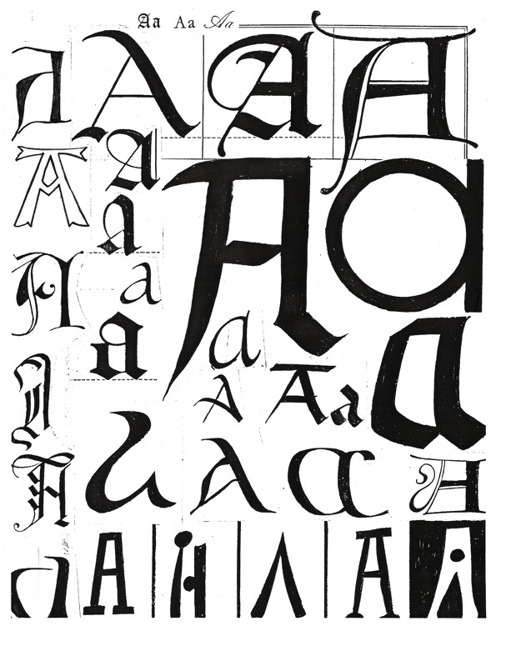
Template matching

Slide 24
Template matching
Template= Internal construct
A large set of templates are represented internally due to learning
Most of all these templates are associated with meaning (at multiple levels at times)
After search+match, a specific path of processing would occur.

Slide 25
Template matching
Strength
  Need an intuitive sense of external to internal match
Weakness
  1:1 is too costly to happen
  Slight mis-alignment not possible to accommodate
  (C-A-R-D) vs (c-a-r-d)
  Time consuming search for so many templates

Slide 26
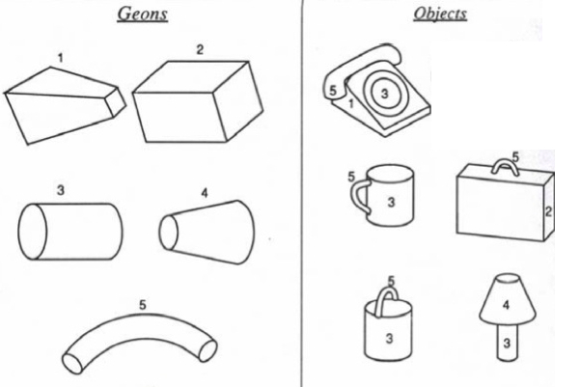
Template matching:
Geon Theory
24 geons
1.4 billion 3-Geon objects, use 30,000, named 3000

Slide 27
Template matching:
Geon Theory
24 geons
1.4 billion 3-Geon objects, use 30,000, named 3000

Slide 28
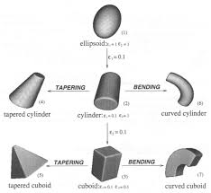
Small transformations into more geons

Slide 29
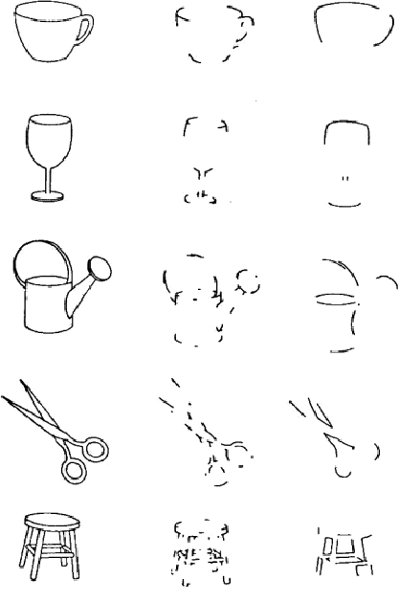
Test for Geon theory

Slide 30
Feature Analysis
Pattern perception is a higher-order complex extraction of information to identity features
A-R-R-O-W
Neurological evidence from neuron recordings
Physiological/Behavioral evidence from Eye movements to extract information
Feature analysis may be a stage of informational analysis that must occur before high-level pattern analysis

Slide 31
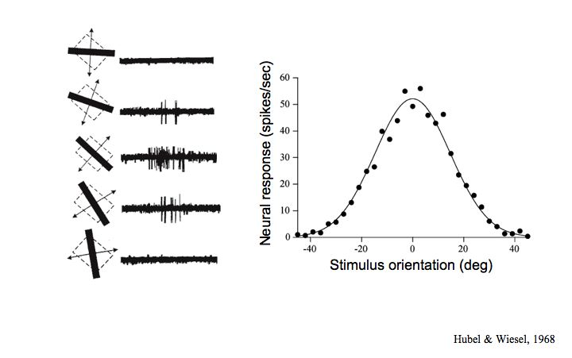
Neuro evidence: Feature Analysis

Slide 32
Prototype Theory
Rather than specific templates or features, we recognize abstracted patterns for a concept.
A pattern is to be compared with a prototype, which many-a-times is the “best” representation of a pattern.
Compatible with neurological economy
Sometimes prototypes cannot be heavily distorted (low error margin): eg. O and Q

Slide 33
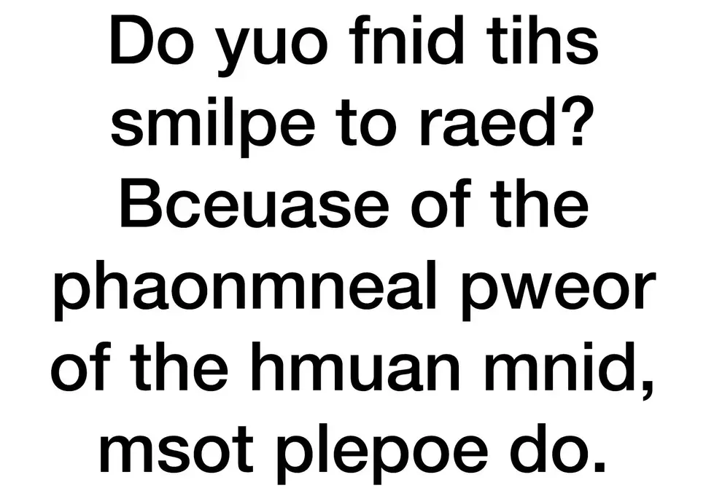
???

Slide 34
Social Perception

